Slide 1
DASC 5301-002
Linear Regression II
Dr Subharag Sarkar
Fall 2023
Slides Courtesy - Rózsa Záruba

Slide 2
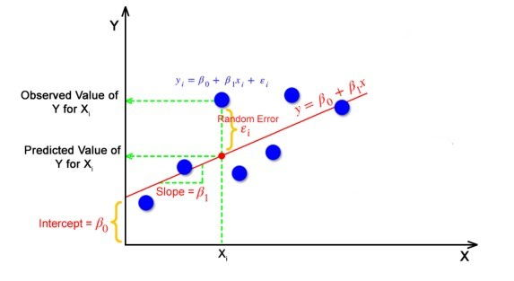
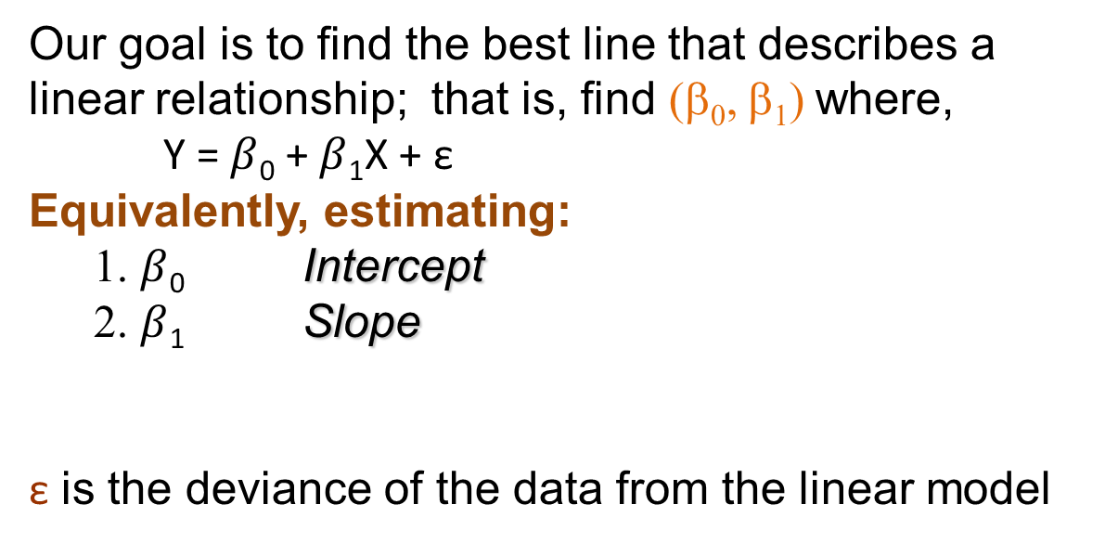
Simple Linear Regression: Model
Our goal is to find the best line that describes a linear relationship; that is, find (β₀, β₁) where,
Y = $β$₀ + $β$₁X + $\text{ε}$
Equivalently, estimating:
1. $β$₀ Intercept
2. $β$₁ Slope
$\text{ε}$ is the deviance of the data from the linear model

Slide 3
Multiple Linear Regression: Model
Data: {(x₁₁,.., x_{1p}),Y₁},….,{(x_{n1},.., x_{np} ),Y_{n}}
Model: Y_{i} =$β$₀ +$β$₁x_{i1} + $β$₂x_{i2} + … + $β$_{p}x_{ip} + $\text{ε}$_{i}, i =1,…,n
Model in Matrix Form: Y = X $β$ + $\text{ε}$
Design Matrix
Response
Error
Coefficients
X = $\left[\begin{matrix}\begin{aligned}1 \text{X}\text{11} \text{X}\text{1}2 … \\ 1 \text{X}\text{21} \text{X}22 … \\ … … … …\end{aligned} & \begin{aligned}\text{X}\text{1}p \\ \text{X}2p \\ …\end{aligned} \\ 1 \text{X}\text{n}\text{1} \text{X}n2 … & \text{X}np\end{matrix}\right]$
Y $=\left(\begin{aligned}Y1 \\ Y2 \\ … \\ Yn\end{aligned}\right)$
$ε=\left(\begin{aligned}\text{ε} 1 \\ \text{ε} 2 \\ … \\ \text{ε} n\end{aligned}\right)$
$$β=\left(\begin{aligned}β0 \\ β1 \\ … \\ βp\end{aligned}\right)$$

Slide 4
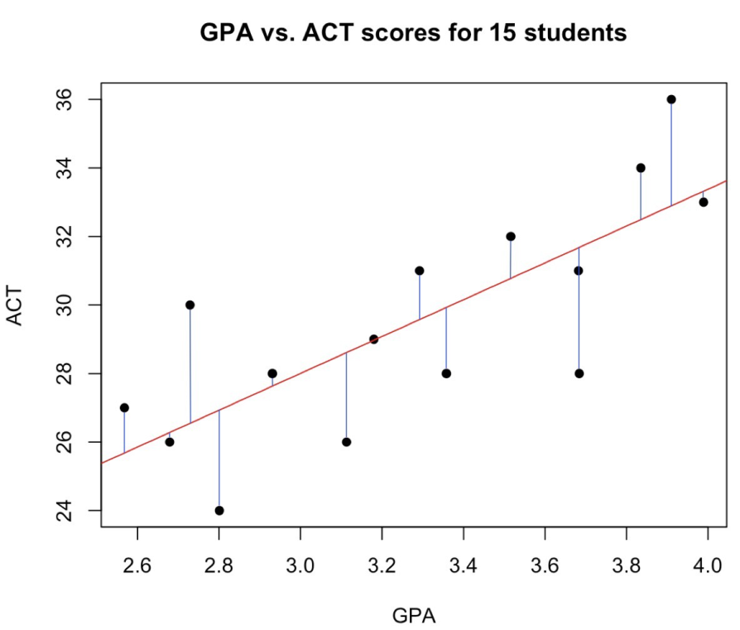
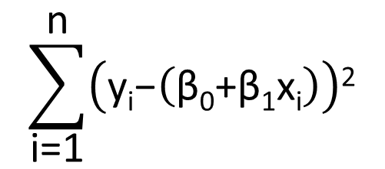

Model Estimation
To estimate (β₀,β₁) , we find values that minimize squared error:
$$\sum_{\text{i}\text{=1}}^{\text{n}}{\left(\text{y}\text{i}\text{−}\left(\text{β}\text{0}\text{+}\text{β}\text{1}\text{x}\text{i}\right)\right)\text{2}}$$
$$\text{ε}$$

Slide 5

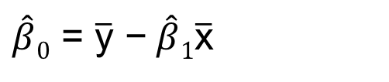
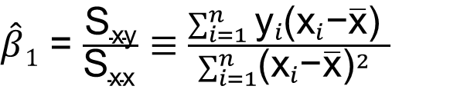
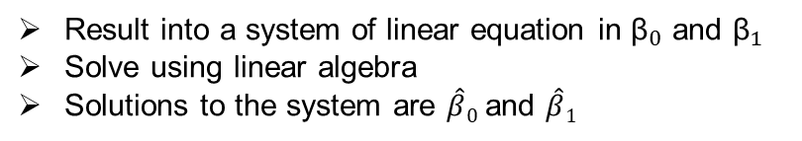
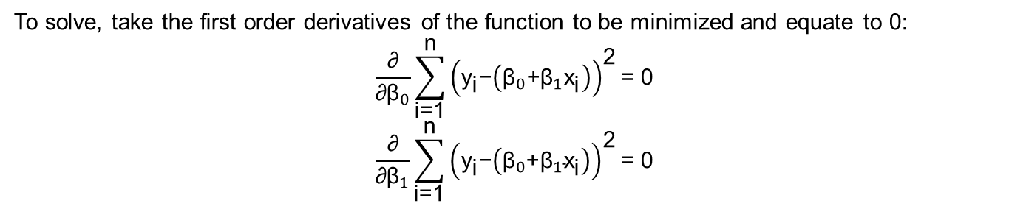
Model Estimation
Begin with the minimization problem:
$$\underset{{\text{β}}_{\text{0}}\text{,}{\text{β}}_{\text{1}}}{\text{min}}{ \sum_{\text{i}\text{=1}}^{\text{n}}{{\left({\text{y}}_{\text{i}}\text{ − }\left({\text{β}}_{0} \text{+ }{\text{β}}_{1}{\text{x}}_{\text{i}}\right)\right)}^{\text{2}}}}$$
To solve, take the first order derivatives of the function to be minimized and equate to 0:
$$\frac{\text{∂}}{\text{∂}{\text{β}}_{0}}\sum_{\text{i}\text{=1}}^{\text{n}}{{\left({\text{y}}_{\text{i}}\text{−}\left({\text{β}}_{0}\text{+}{\text{β}}_{1}{\text{x}}_{\text{i}}\right)\right)}^{\text{2}}}\text{= 0}$$
$$\frac{\text{∂}}{\text{∂}{\text{β}}_{1}}\sum_{\text{i}\text{=1}}^{\text{n}}{{\left({\text{y}}_{\text{i}}\text{−}\left({\text{β}}_{0}\text{+}{\text{β}}_{1}{\text{x}}_{\text{i}}\right)\right)}^{\text{2}}}\text{= 0}$$
$\hat{β}0$ = $\overline{\text{y}}\text{ −} \hat{β}1\overline{\text{x}}$
Result into a system of linear equation in ${\text{β}}_{0}$ and ${\text{β}}_{1}$
Solve using linear algebra
Solutions to the system are $\hat{β}0$ and $\hat{β}1$
$\hat{β}1$ = $\frac{\text{S}\text{xy}}{\text{S}\text{xx} }$ $≡$ $\frac{\sum_{i=1}^{n}{{\text{y}}_{i}\text{(}{\text{x}}_{i}\text{−}\overline{\text{x}}\text{)}} }{\sum_{i=1}^{n}{{\text{(}{\text{x}}_{i}\text{−}\overline{\text{x}}\text{)}}^{2}} }$

Slide 6
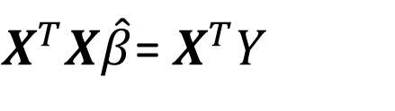
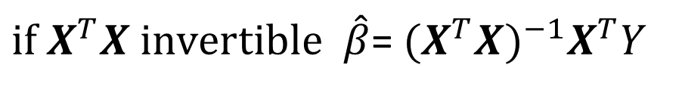
Parameter Estimation (β₀,β₁,β₂,…,β_{p}) , σ²
To estimate (β₀,β₁,β₂,…,β_{p}) , we find values that minimize squared error:
The fitted values are:
Where H is called the hat matrix.
The residual are:
Notes:
The objective is to find values of Beta which will minimize the squared errors.
In matrix notation, the problem is formulated using the so-names normal equation (xtxbeta=xty)
Since x is capable of being inverted, we can right the formula like this.
So yhat=xbeta hat, so if I substitute the vale of beta hat, I get this whole thing.
The hat matrix provides a measure of leverage. It is useful for investigating whether one or more observations are outlying with regard to their X values, and therefore might be excessively influencing the regression results.
The hat matrix is also known as the projection matrix because it projects the vector of observations, y, onto the vector of predictions, ˆy, thus putting the "hat" on y. The hat matrix H is defined in terms of the data matrix X:
I is index matrix
So once the residual is known, I can count the MSE which is epsilon epsilon / n-p-1

Slide 7
Different Roles of Predicting Variables
Predicting Variables can be distinguished as:
Controlling – to control for bias selection in the sample. They are used as ‘default’ variables in order to capture more meaningful relationships.
Explanatory –to explain variability in the response variable; they may be included in the model even if other “similar” variables are in the model;
Predictive – to best predict variability in the response regardless of their explanatory power.

Slide 8
Confidence Interval

Slide 9
Confidence Interval
Confidence intervals measure the degree of uncertainty or certainty in a sampling method.
They can take any number of probability limits, with the most common being a 95% or 99% confidence level.
Confidence intervals are conducted using statistical methods, such as a t-test.

Slide 10
Confidence Interval
It is used to measure uncertainty in an estimate of a population parameter based on a sample.
Example, a researcher selects different samples randomly from the same population and computes a confidence interval for each sample to see how it may represent the true value of the population variable.
The resulting datasets are all different; some intervals include the true population parameter and others do not.

Slide 11
Confidence Interval Estimation
We can derive confidence intervals for β_{j}
Is β_{j} statistically significant? Check whether zero is in the confidence interval

Slide 12
Testing Statistical Significance
Test for statistical significance of β_{j} given all other predicting variables in the model by using the t-test for
H₀: β_{j} = 0 vs. H_{a}: β_{j} ≠ 0
We reject H₀ if |t| gets too large.
We interpret this as β_{j} being statistically significant if the null hypothesis is rejected.
Or look at the p-value and if it is very small reject the null hypothesis

Slide 13
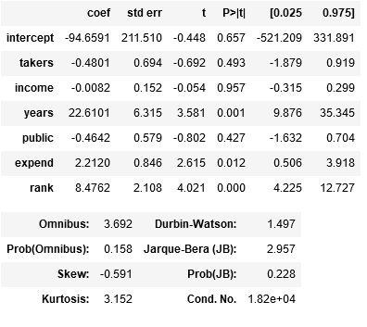
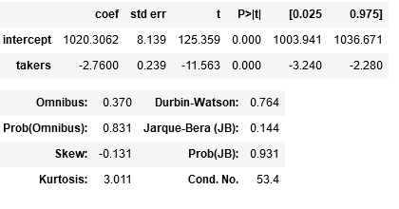
OLS Output Confidence Intervals
Notes:
Common choice in significant testing is a 5 % significant threshold. It’s a two tailed testing so 2.5% on both sides.

Slide 14
OLS Output T-stat/P-value
Notes:
The larger the number of degree of freedom the smaller the p.
The t value is easy to measure and doesn’t help if number of degree of freedom is not known.
65% chance that if null hypothesis is true that random chance can produce -94.
Significant test can only rule out the null hypothesis.

Slide 15
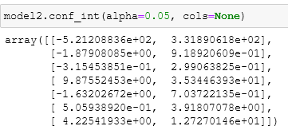
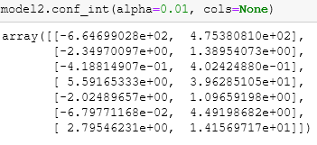
Confidence Interval Comparison
95% confidence interval
99% confidence interval
What do you notice?
Notes:
The Confidence interval is higher in 99% than in 95%. Range will be bigger but mean will be identical. It’s the same dataset.
The tail contains 2.5 and 2.5 on the left and 0.5 and 0.5 on the right.
Ranges which doesn’t have 0 inside range, null hypothesis is not possible.

Slide 16
Testing Overall Regression Goodness of Fit test
Goodness of Fit test:
It is an F-test
H₀ : β₀= β₁ =…= β_{p}=0
H_{A} : at least one of them ≠ 0
We reject H₀ if F-statistic is large (F-statistic>F_{α,p,n-p-1}); Which means that at least one of the coefficients is different from zero at the α significant level.
The p-value of the test is: P(F_{p,n-p-1} > F-statistic) where F_{p,n-p-1} is the F-distribution with p and n-p-1 degrees of freedom.
Notes:
The term goodness-of-fit refers to a statistical test that determines how well sample data fits a distribution from a population with a normal distribution.
Put simply, it hypothesizes whether a sample is skewed or represents the data you would expect to find in the actual population.
F test is a variance test. If the variance matches the assumption.

Slide 17
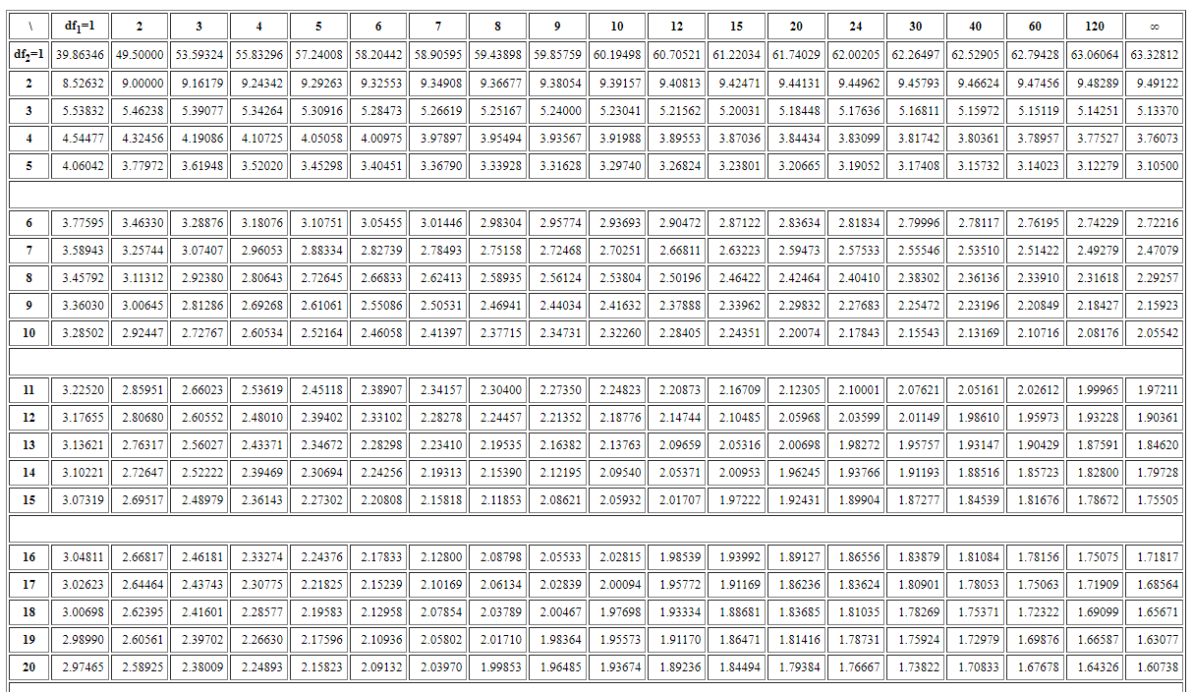

Slide 18
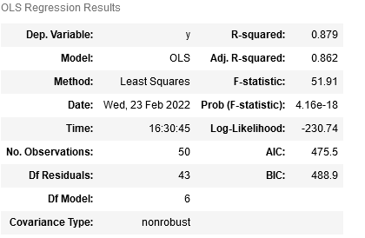
Example: Goodness of Fit test
c. Test for overall regression
F-value=51.91, p-value ≈ 0
Reject the null, at least one of the variables have explanatory power

Slide 19
ANOVA

Slide 20
ANOVA
Analysis of variance (ANOVA) is an analysis tool used in statistics.
It splits an observed aggregate variability found inside a data set into two parts: systematic factors and random factors.
The systematic factors have a statistical influence on the given data set, while the random factors do not.
Analysts use the ANOVA test to determine the influence that independent variables have on the dependent variable in a regression study.
ANOVA is also called the Fisher analysis of variance, and it is the extension of the t- and z-tests.

Slide 21
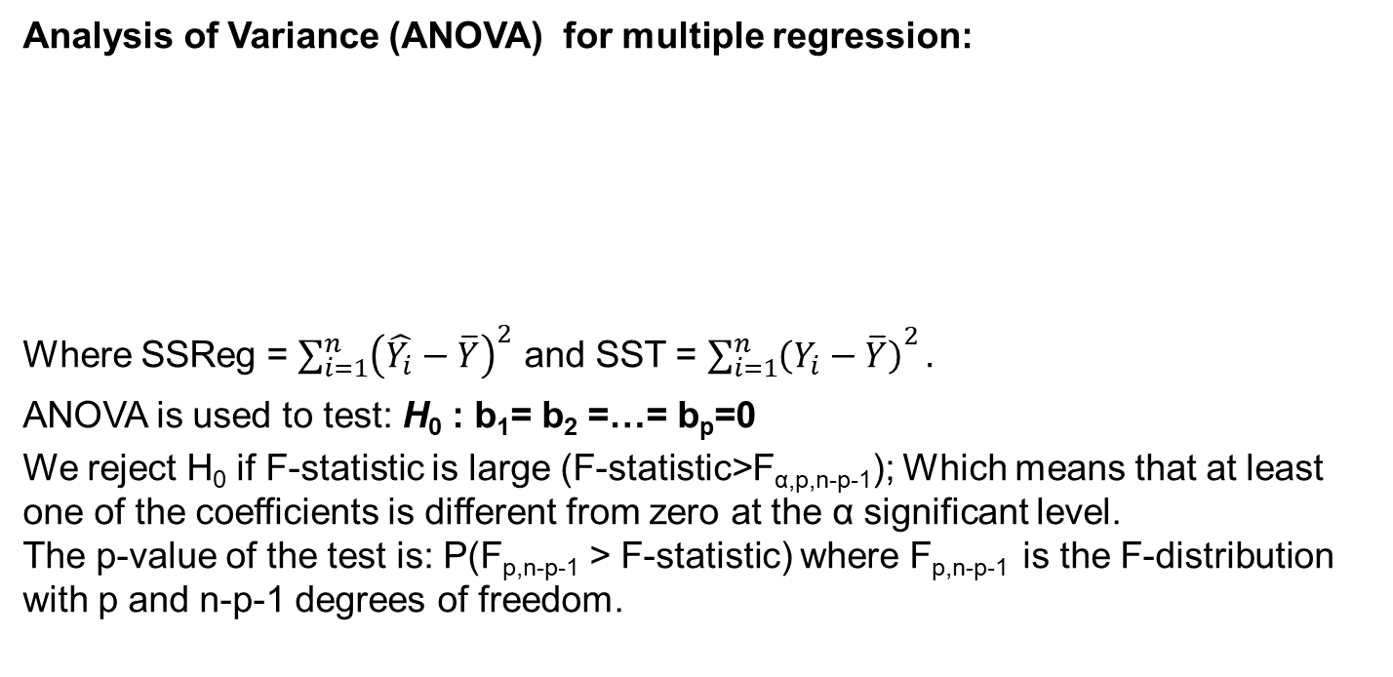
Testing Subset of Coefficients
Analysis of Variance (ANOVA) for multiple regression:
Where SSReg = ${\sum_{i=1}^{n}{\left(\hat{Y_{i}}−\overline{Y}\right)}}^{2}$ and SST = ${\sum_{i=1}^{n}{\left(Y_{i}−\overline{Y}\right)}}^{2}.$
ANOVA is used to test: H₀ : b₁= b₂ =…= b_{p}=0
We reject H₀ if F-statistic is large (F-statistic>F_{α,p,n-p-1}); Which means that at least one of the coefficients is different from zero at the α significant level.
The p-value of the test is: P(F_{p,n-p-1} > F-statistic) where F_{p,n-p-1} is the F-distribution with p and n-p-1 degrees of freedom.
Source | DF | Sum of Sq | Mean SS | F-statistic
Regression | p | SSReg | SSReg/p | MSSReg/MSE
Residual | n-p-1 | SSE | SSE/n-p-1
Total | n-1 | SST

Slide 22
ANOVA
The ANOVA test is the initial step in analyzing factors that affect a given data set.
Once the test is finished, an analyst performs additional testing on the methodical factors that measurably contribute to the data set's inconsistency.
The analyst utilizes the ANOVA test results in an f-test to generate additional data that aligns with the proposed regression models.

Slide 23
ANOVA
The ANOVA test allows a comparison of more than two groups at the same time to determine whether a relationship exists between them.
The result of the ANOVA formula, the F statistic (also called the F-ratio), allows for the analysis of multiple groups of data to determine the variability between samples and within samples.
If no real difference exists between the tested groups, which is called the null hypothesis, the result of the ANOVA's F-ratio statistic will be close to 1.
The distribution of all possible values of the F statistic is the F-distribution.
This is actually a group of distribution functions, with two characteristic numbers, called the numerator degrees of freedom and the denominator degrees of freedom.

Slide 24
Testing Subsets of Coefficients
More generally, consider the full model
Y =b₀ + b₁x₁ + b₂x₂ +…+ b_{p}x_{p} + α₁z₁ + α₂z₂ +…+ α _{q}z_{q} +e
With two sets of predictors(X₁,X₂,…,X_{p}) and (Z₁,Z₂,…,Z_{q}) for example, the first set can represent controlling factors and the second set can represent explanatory factors. We test:
H₀ : α₁= α₂ =…= α_{q} =0 versus H_{A} : at least one is not zero
Partial F-test:
We reject H₀ if F-statistic is large (F-statistic>Fα,q,n-p-q-1); Which means that at least one of the coefficients is different from zero at the α significant level.

Slide 25
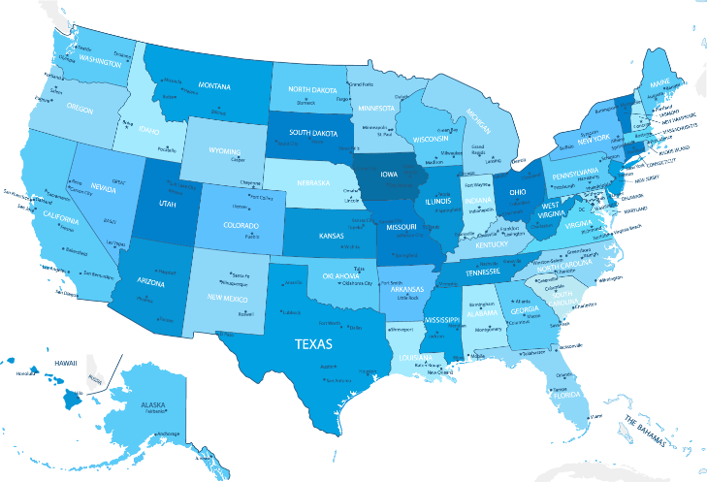
Linear Regression: Example
Controlling factors:
X₁ = % of total eligible students in the state who took the exam
X₆ = median percentile of ranking of test takers within their secondary school classes
Explanatory Factors:
X₂ = median income of families of test takers, in hundreds of dollars
X₃ = average number of years that test takers had in social sciences, natural sciences, and humanities
X₄ = % of test takers who attended public schools
X₅ = state expenditure on secondary schools, in hundreds of dollars per student
SAT Mean Score by State – Year 1982
790 (South Carolina) -1088 (Iowa)
Notes:
I will use this example to illustrate concepts

Slide 26
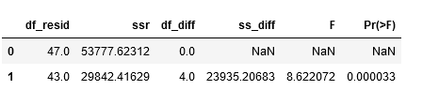
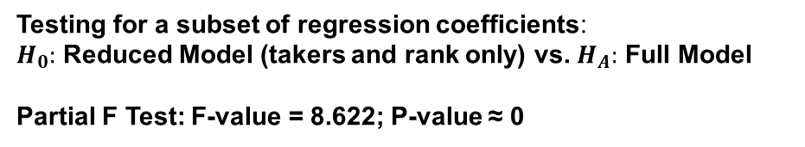
Example : Testing subset of coefficients
Given X₁ and X₆ (takers and rank) are controlling factors, test the null hypothesis that the coefficients of the rest of predictors are zero. Clearly state the hypothesis test. Show how you perform the test. Interpret the results.
Reject the null hypothesis, some of the additional variables in the full model have explanatory power
Testing for a subset of regression coefficients:
$H_{0}:$ Reduced Model (takers and rank only) vs. $H_{A}:$ Full Model
Partial F Test: F-value = 8.622; P-value ≈ 0

Slide 27
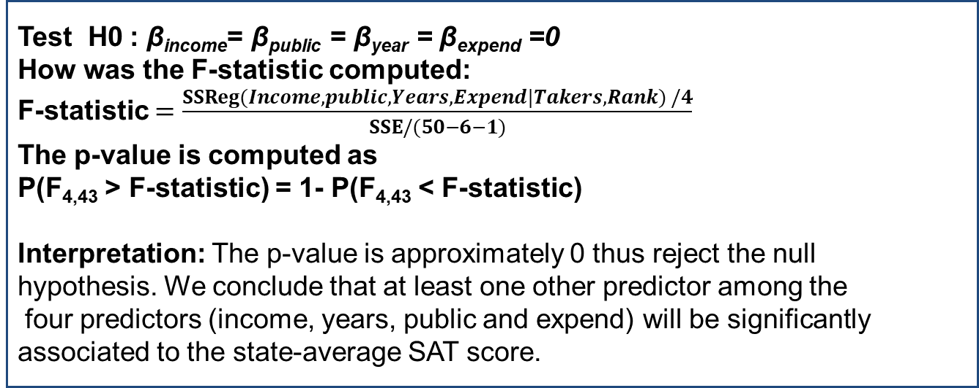
Example 2: Inference on Coefficients
Test H0 : β_{income}= β_{public} = β_{year} = β_{expend} =0
How was the F-statistic computed:
F-statistic $=\frac{SSReg(Income, public, Years, Expend|Takers,Rank) /4}{SSE/(50−6−1)}$
The p-value is computed as
P(F_{4,43} > F-statistic) = 1- P(F_{4,43} < F-statistic)
Interpretation: The p-value is approximately 0 thus reject the null
hypothesis. We conclude that at least one other predictor among the
four predictors (income, years, public and expend) will be significantly
associated to the state-average SAT score.

Slide 28
Estimating the Regression Line

Slide 29

Estimating the Regression Line
At some selected value of x (say x*), we estimate the “mean response” of Y (or the regression line) via
Because the estimators of β are normally distributed, so is $\hat{Y}$. That means we can draw inference on the regression line using $\hat{Y}$ if we know the expected value and variance.

Slide 30
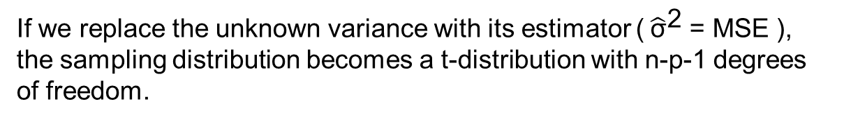
Estimating the Regression Line
$\hat{Y}$ has a normal distribution with
If we replace the unknown variance with its estimator (${\hat{\text{σ}}}^{\text{2}}$ = MSE ), the sampling distribution becomes a t-distribution with n-p-1 degrees of freedom.

Slide 31
Estimation vs. Prediction
Interpretations of estimated mean response:
If x* is one of the observations for the predicting variable, then we use estimation.
Estimated regression line for the value x* is interpreted as the average estimated mean response for all settings under which the predicting variable is equal to x*.
If x* is a new observation of the predicting variables, then we use prediction.
Predicted regression line for the value x* is interpreted as the estimated mean response for one setting under which the predicting variable is equal to x*.

Slide 32
Predicting a New Response
One of the primary motivations for regression is to use the regression equation to predict future responses. The prediction is the same as the estimator for the mean response.
But a prediction is not the same as the line estimate. The prediction contains two sources of uncertainty:
1. Due to the new observation/s
2. Due to parameter estimates (of b’s)

Slide 33
Predicting a New Response (cont’d)
Variation of the estimated regression line:
Variation of a new measurement: s²
The new observation is independent of the regression data, so the total variation in predicting Y* | x* is

Slide 34
Assumption of Diagnostics

Slide 35
Multiple Linear Regression: Model
Data: {(x₁₁,.., x_{1p}),Y₁},….,{(x_{n1},.., x_{np} ),Y_{n}}
Model: Y_{i} = b₀ + b₁x_{i1} + b₂x_{i2} +…+ b_{p}x_{ip} + e_{i}, i = 1,…,n
Assumptions:
Linearity Assumption: The relationship between Y and X_{j} is linear for all predicting variables
Constant Variance Assumption: Var(e_{i}) = s²
Independence Assumption: {e₁,…, e_{n}} are independent random variables
Normality Assumption: e_{i} ~ Normal

Slide 36
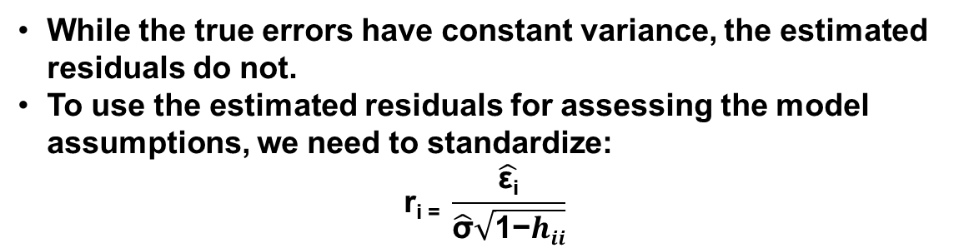
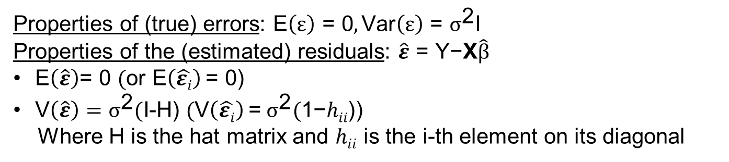
Properties of the Errors & Residuals
Properties of (true) errors: $\text{E}\left(ε\right) \text{= 0},\text{Var}\left(ε\right) \text{= }σ^{\text{2}}\text{I}$
Properties of the (estimated) residuals: $\hat{ε} \text{= }\text{Y}\text{−}\text{X}\hat{β}$
$\text{E}\left(\hat{ε}\right)\text{= 0 }(\text{or} \text{E}\left(\hat{εi}\right) \text{= 0}$)
$\text{V}\left(\hat{ε}\right)=σ^{\text{2}}(\text{I}$-H) $(\text{V}\left(\hat{εi}\right) \text{=} σ^{\text{2}}(\text{1−}hii\text{)}$)
Where H is the hat matrix and $hii$ is the i-th element on its diagonal
While the true errors have constant variance, the estimated residuals do not.
To use the estimated residuals for assessing the model assumptions, we need to standardize:
$$\text{r}\text{i}\text{ =} \frac{\hat{\text{ε}\text{i}}}{\hat{\text{σ}}\sqrt{\text{1−}hii}}$$

Slide 37
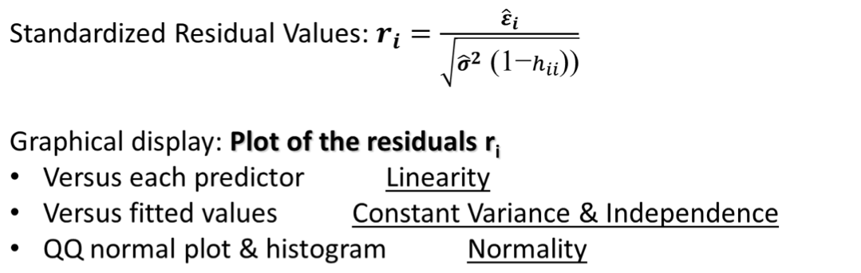
Residuals Analysis
We evaluate the normality assumption using the residuals not the response variable.
We do not check the predicting variables for normality; however, if the distribution of a predicting variable is strongly skewed, it is possible that the linearity assumption with respect to that variable will not hold.
Notes:
Using the residual Plots, we can check if the assumptions hold or not.

Slide 38
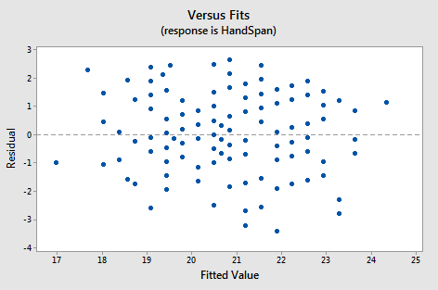
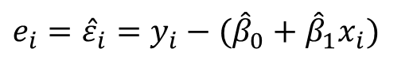
Residual Analysis
Residual Values:
Graphical display: Plot of the residuals e_{i}
If the scatter of e_{i} is not random around zero line, it could be that
The relationship between X and Y is not linear
Variances of error terms are not equal
Response data are not independent
$$e_{i}={\hat{ε}}_{i}=y_{i}−({\hat{β}}_{0}+{\hat{β}}_{1}x_{i})$$
Notes:
We we can say that the linearity assumption holds

Slide 39
Checking Assumptions: Residual Analysis
Linearity Assumption:
This shows that there may be a non-linear relationship between X and Y.
Notes:
Linearity of Residuals:
There needs to be a linear relationship between the dependent variable and independent variable(s).

Slide 40
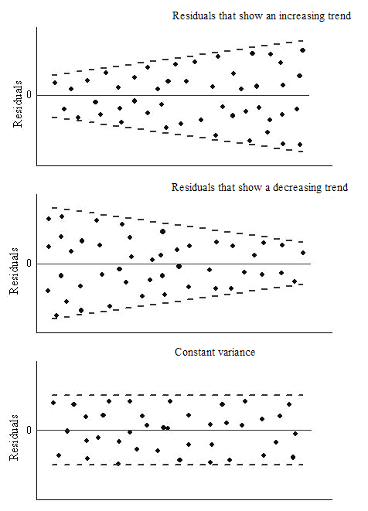
Checking Assumptions: Residual Analysis
Constant Variance Assumption:
The residuals show larger variance as the predicting variable increases.
Here, it could be that s² is not constant.
Notes:
Hence we can say we observe Heteroscedasticity, in this example

Slide 41
Checking Assumptions: Residual Analysis
Independence Assumption:
There are clusters of residuals: the independence assumption does not hold.
Using residual analysis, we check for uncorrelated errors but not independence.
Independence is a more complicated matter. If the data are from a randomized trial, then independence is established, but most data are from observational studies.
Notes:
Independence Assumption
The error terms should not be dependent on one another.
There should be no correlation between the residual terms.

Slide 42
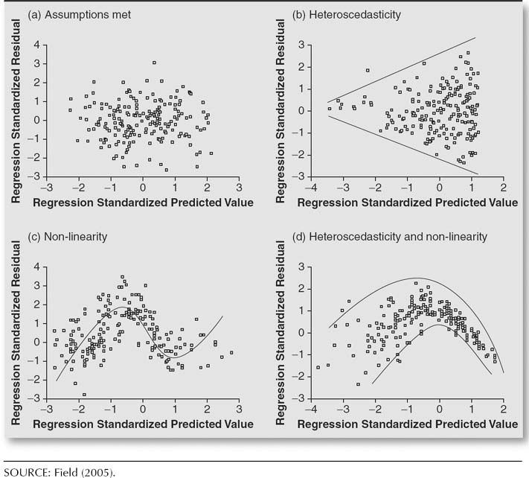

Slide 43
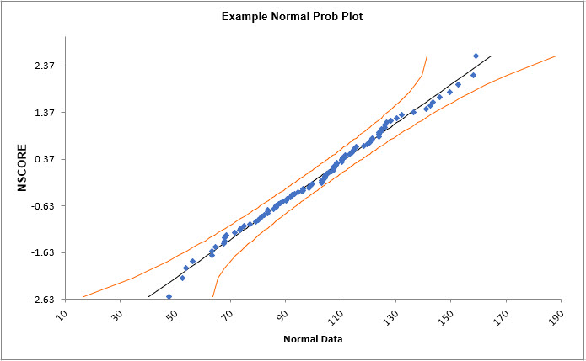
Checking the Assumption of Normality
One way to check this assumption in a regression is using a Normal Probability Plot
Let the software do this for you!
A straight line in normal probability plot implies assumption of normality is valid
Curviture (especially at the ends) shows non-normality
x-axis:
y-axis: e_{i}
r_{i} = rank of e_{i} (between 1, n)
F = CDF of Normal Distribution
Notes:
Normal Distribution of Residuals:
The mean of residuals should follow a normal distribution with a mean equal to zero or close to zero.
This is done in order to check whether the selected line is actually the line of best fit or not.
If the error terms are non-normally distributed, suggests that there are a few unusual data points that must be studied closely to make a better model.

Slide 44
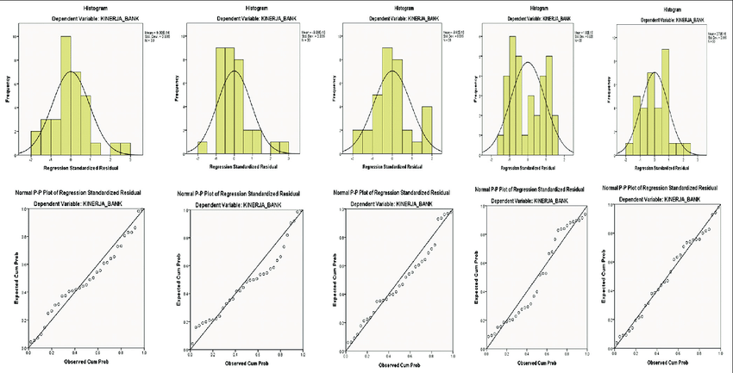

Slide 45
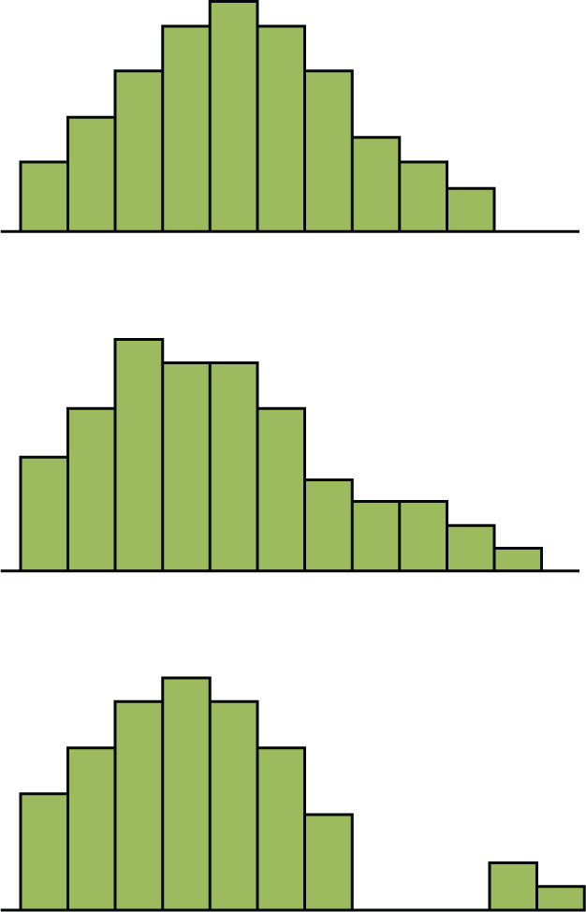
Checking the Assumption of Normality
A complementary approach to check for the normality assumption is by plotting the histogram of the residuals
Normality Assumption:
The residuals should have an approximately symmetric distribution, unimodal, and with no gaps in the data.

Slide 46
Variable Transformation
If the model fit is inadequate, it does not mean that a regression is not useful.
One problem might be that the relationship between X and Y is not exactly linear.
To model the nonlinear relationship, we can transform X by some nonlinear function such as:

Slide 47
Normality Transformations
Problem: Normality assumption does not hold. Solution: Transform the response variable from y to y* via y* = y^{l}
where the value of λ depends on how Var(Y) changes as X changes.
Table 1: Common Box-Cox Transformations
l | Y’
-2 | Y⁻² = 1/Y²
-1 | Y⁻¹ = 1/Y¹
-0.5 | Y^{-0.5} = 1/(Sqrt(Y))
0 | log(Y)
0.5 | Y^{0.5} = Sqrt(Y)
1 | Y¹ = Y
2 | Y²
This is called Box-Cox Transformation: The parameter λ can be determined using statistical software.

Slide 48
Outliers and Predictive Power

Slide 49
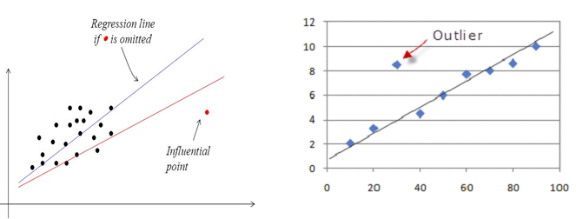
Outliers in Regression
Any data point that is far from the majority of the data (in either or both x and y) is called an outlier.
Data points that are far from the mean of the x’s are called leverage points.
A data point that is far from the mean of either or both the x’s and/or the y’s are influential points if they influence the fit of the regression. Influential points can change the values of the estimated parameters significantly.
The upshot: Sometimes there are good reasons for excluding subsets (there were errors in the data entry; there were errors in the experiment). Sometimes - the outlier belongs in the data. Outliers should always be examined.
Notes:
An outlier is an observation that is unusually small or large.
Often a regression line will differ greatly depending upon what subsets of the data are included.

Slide 50
Influential Points and Leverage Points
Influential observation: Point that if it is removed would significantly change the statistical analysis. For simple linear regression, points that are outliers in the X direction are often influential
Leverage point: Point that is an outlier in the x direction that has a potential to be influential. It will be influential if its residual is of moderately large magnitude (another way to think of it: unusual x value that have little effect on the regression coefficients).

Slide 51
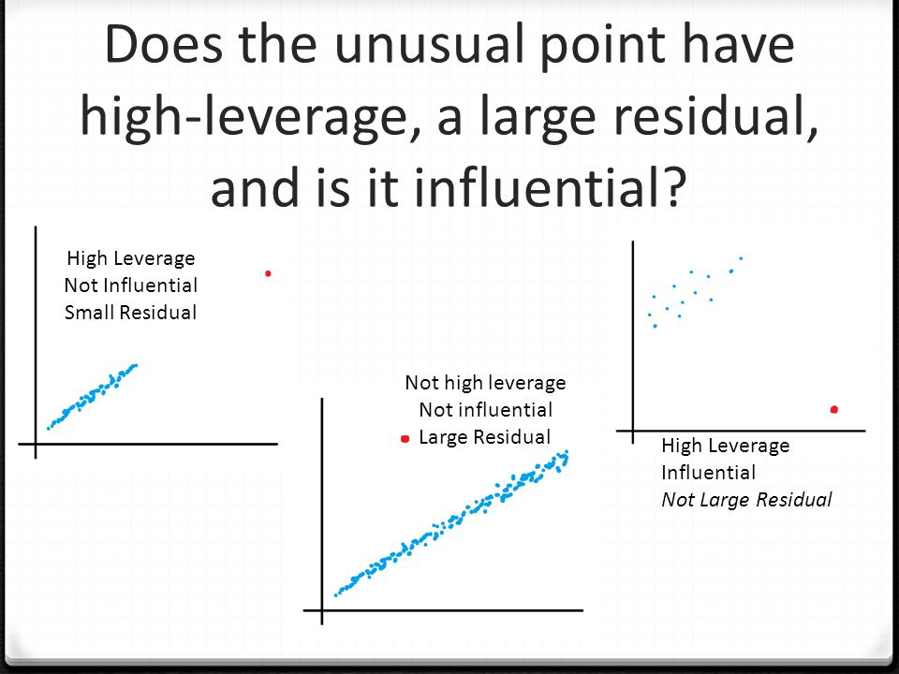
Notes:
An outlier is an observation that is unusually small or large.
Often a regression line will differ greatly depending upon what subsets of the data are included.

Slide 52
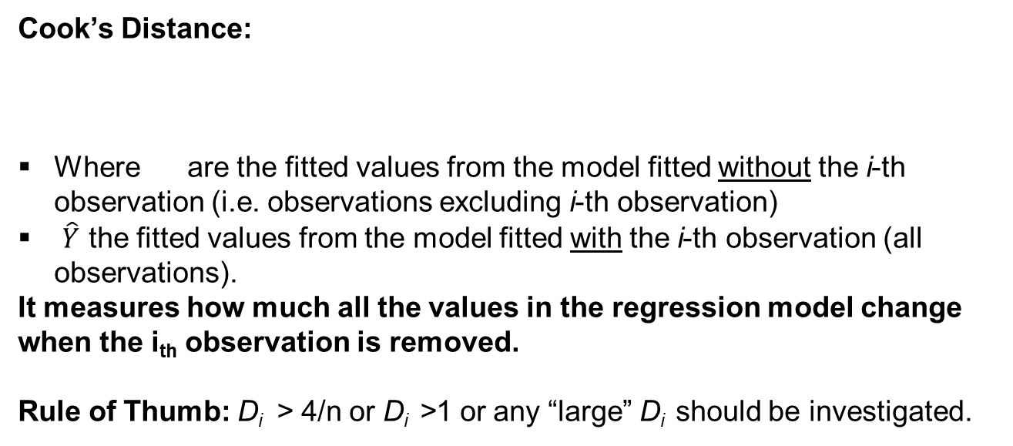
Checking for Outliers
Cook’s Distance:
Where are the fitted values from the model fitted without the i-th observation (i.e. observations excluding i-th observation)
$\hat{Y}$ the fitted values from the model fitted with the i-th observation (all observations).
It measures how much all the values in the regression model change when the i_{th} observation is removed.
Rule of Thumb: D_{i} > 4/n or D_{i} >1 or any “large” D_{i} should be investigated.
Notes:
Q is the number of coefficients

Slide 53
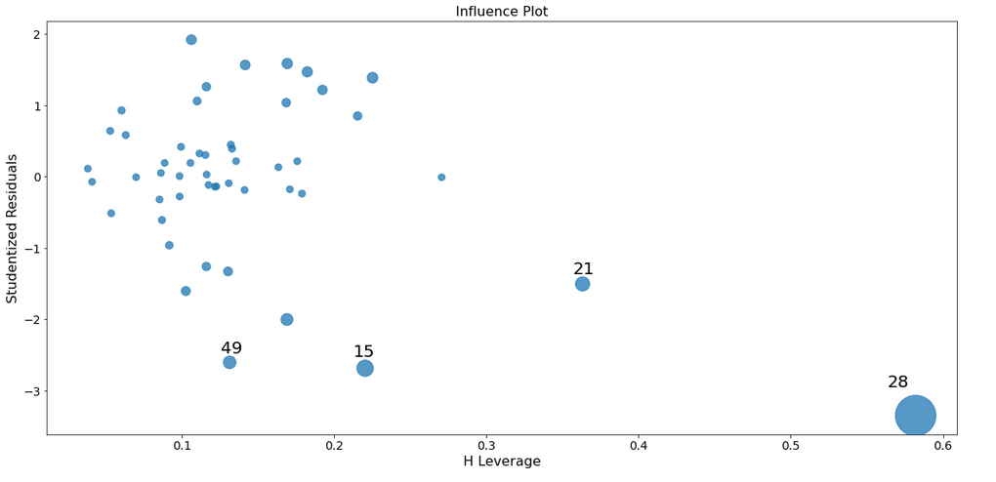
Outliers

Slide 54
Residual Analysis: Example
Do the assumptions hold? Provide the graphical displays needed to support the diagnostics. Interpret.
If one or more assumptions do not hold, what transformations do you suggest? Did the residual diagnoses improved with the suggested transformations?
Do you identify any outliers?

Slide 55
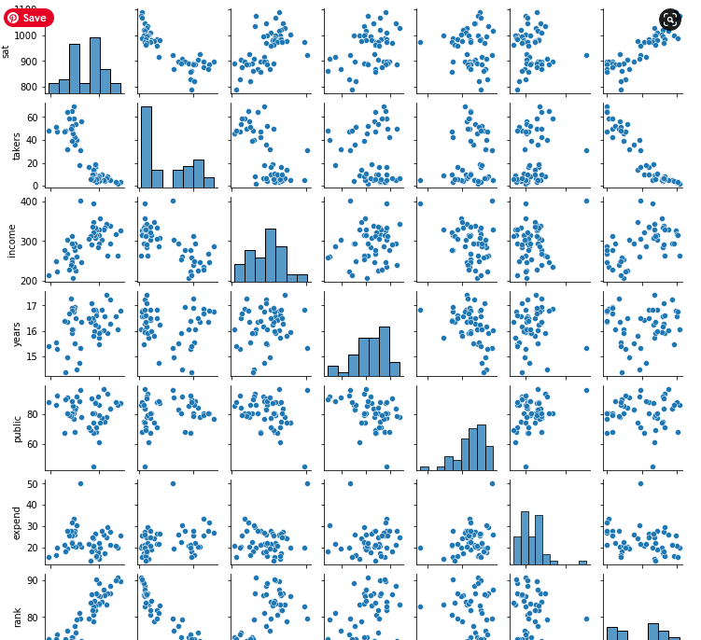
Linearity Assumption

Slide 56
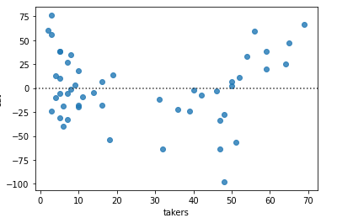
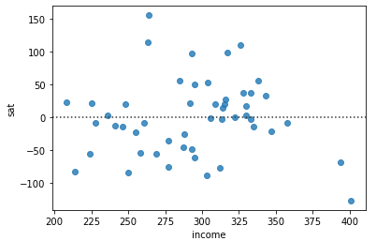
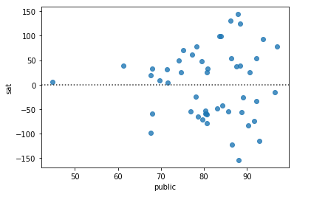
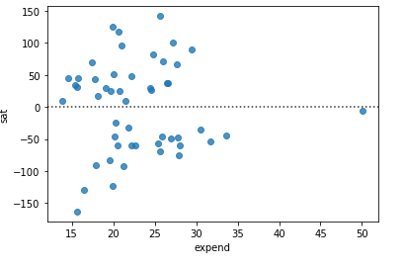
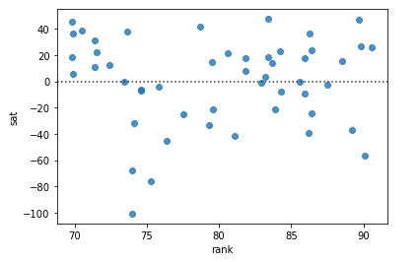
Linearity Assumption
Notes:
Linearity of Residuals:
There needs to be a linear relationship between the dependent variable and independent variable(s).

Slide 57
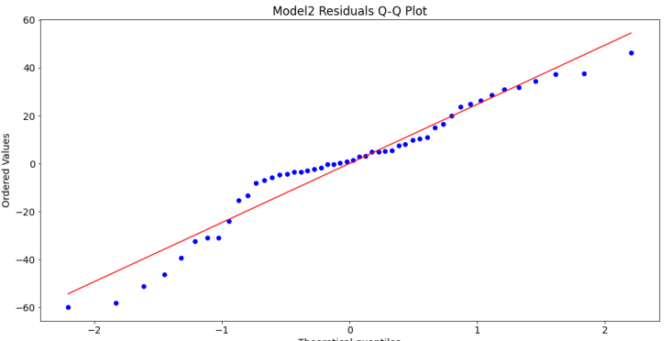
Residual Analysis: Normality Assumption
Jarcera-Berra test for normality:
[('Jarque-Bera', 2.956525016294984),
('Chi^2 two-tail prob.', 0.22803355081699117),
('Skew', -0.5907481228442272),
('Kurtosis', 3.152310962329308)]
H0: the errors are normally distributed
Ha: errors are not normal
We cannot reject the null hypotheses => normality holds
Notes:
A straight line in normal probability plot implies assumption of normality is valid
Curviture (especially at the ends) shows non-normality

Slide 58
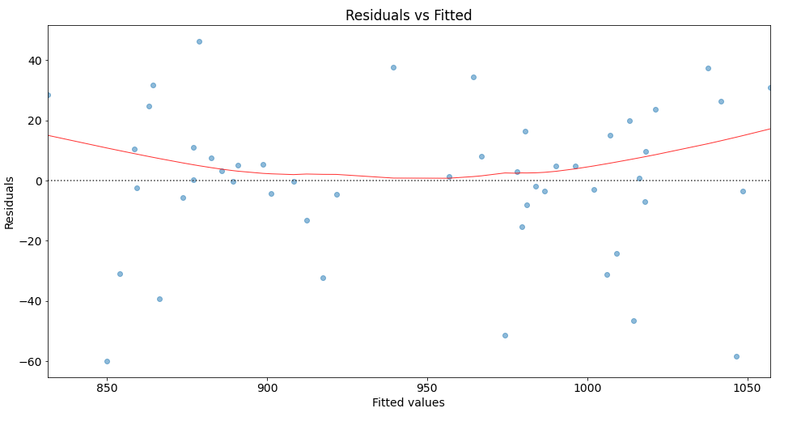
Residual Analysis: Constant Variance
Bruesch-Pagan test for homoscedasticity:
[('Lagrange multiplier statistic', 6.24871244991414),
('p-value', 0.39591378870778604),
('f-value', 1.0235684875129305),
('f p-value', 0.4231160404998923)]
H0: the errors constant variance
Ha: heteroscedasticity
We cannot reject the null hypotheses => constant variance holds

Slide 59
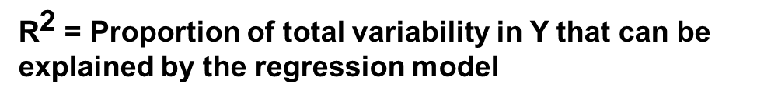
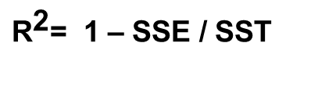

Coefficient of Determination
$${\text{R}}^{\text{2}}$$
A statistic that efficiently summarizes how well the X’s can be used to predict Y is the R-square:
${\text{R}}^{\text{2}}$= 1 – SSE / SST
which is interpreted as
${\text{R}}^{\text{2}}$ = Proportion of total variability in Y that can be explained by the regression model

Slide 60
Model Evaluation
1. F-test for H₀: b₁= b₂ = ....= b_{k}=0
F₀ = MSR / MSE ~ F( k, n-k-1 )
MSR = SSR/k MSE = SSE/n-k-1
2. Coefficient of determination:
R² = SSR/SST
R² will always increase if we add more predicting variables
3. Adjusted Coefficient of determination:
adjusted R² =1 – (n-1)(1-R² )/(n-k-1)

Slide 61
Correlation Coefficient
A statistic that efficiently summarizes how well the X’s are linearly related to Y is the correlation coefficient:
It can be used to evaluate the linear relationship between the response variable and the predicting variables;
It can also be used to evaluate the correlation between the predicting variables for detecting (near) linear dependence among the variables (or multicollinearity).

Slide 62
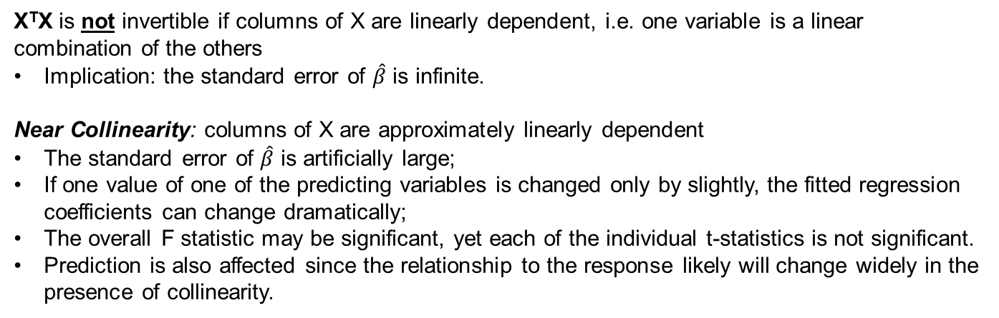
Multicollinearity
To estimate (b₀,b₁,b₂,…,b_{p}): find values minimizing squared error:
if X^{T}X invertible
X^{T}X is not invertible if columns of X are linearly dependent, i.e. one variable is a linear combination of the others
Implication: the standard error of $\hat{β}$ is infinite.
Near Collinearity: columns of X are approximately linearly dependent
The standard error of $\hat{β}$ is artificially large;
If one value of one of the predicting variables is changed only by slightly, the fitted regression coefficients can change dramatically;
The overall F statistic may be significant, yet each of the individual t-statistics is not significant.
Prediction is also affected since the relationship to the response likely will change widely in the presence of collinearity.

Slide 63
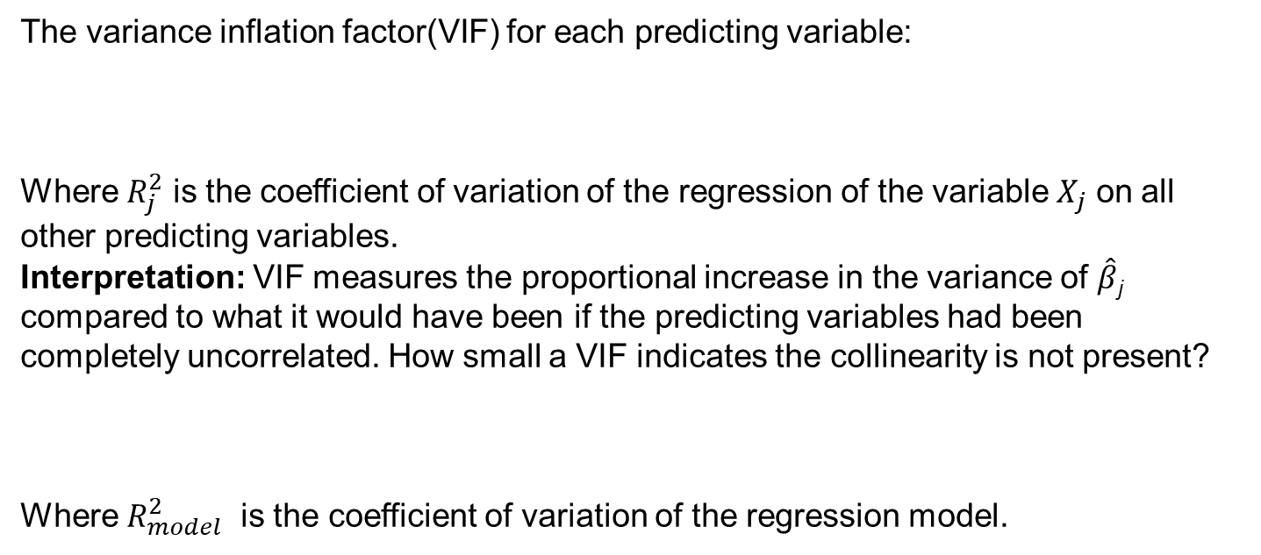
Multicollinearity Diagnosis
The variance inflation factor(VIF) for each predicting variable:
Where $R_{j}^{2}$ is the coefficient of variation of the regression of the variable $X_{j}$ on all other predicting variables.
Interpretation: VIF measures the proportional increase in the variance of $\hat{β}$_{j} compared to what it would have been if the predicting variables had been completely uncorrelated. How small a VIF indicates the collinearity is not present?
Where $R_{model}^{2}$ is the coefficient of variation of the regression model.
Notes:
It means that either the predictors are more related to the target variable than they are to each other, or they are not related to each other very much.
In these circumstances coefficient estimates are not very likely to be very unstable, so collinearity is not a problem.
What can we do about multicollinearity? Don’t use all the variables; use variable selection (stay tuned...). Multicollinearity is just an extreme example of the bias-variance tradeoff we face whenever we do regression. If we include too many variables, we get poor predictions due to increased variance (more later).

Slide 64
Model Evaluation: Example
What are the correlation coefficients between the quantitative predicting variables? Any potential multicollinearity?
Obtain the variance inflation factors for the quantitative predicting variables. Any potential multicollinearity?
What is the coefficient of determination? Interpret.

Slide 65
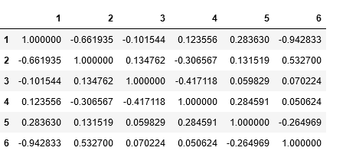
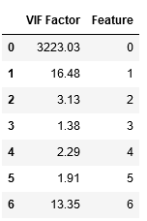

Model Evaluation: Example
The maximum correlation between predicting variables is 0.94.
Two of the VIFs are greater than max(10, 1/(1-$R^{2}$)) = max(10, 8.2)=10.
The coefficient of determination is 0.879. Thus the model explains 87.9% of the variability in the SATs.

Slide 66

Example
Independent errors=> Durbin Watson test (close to 2 is ideal)
Normality test=> Jarque Bera (look at the prob(JB)
Constant variance=> Omnibus (prob(Omnibus))

